Slide 1

Bonolo Masima: Supervisor Meeting 3
Thurs 2 July 2026 15:30 – Rankine

Slide 2
Causal Inference for Robotic Grasp Failure Diagnosis under Perceptual Degradation
Phase 1
Phase 2
Phase 3
Phase 4
Simulation Pipeline
Data Collection
Structural Causal Model
LLM Baseline
COMPLETE
COMPLETE
In progress
UPCOMING
MuJoCo scene • Contact-GraspNet IK controller • 432-trial experiment
Factorial grid (4×4×3×3×3) 432 trials • CSV logged
Fit SCM on collected data Counterfactual diagnosis
Zero-shot GPT-4o prompting Comparison with SCM accuracy

Slide 3
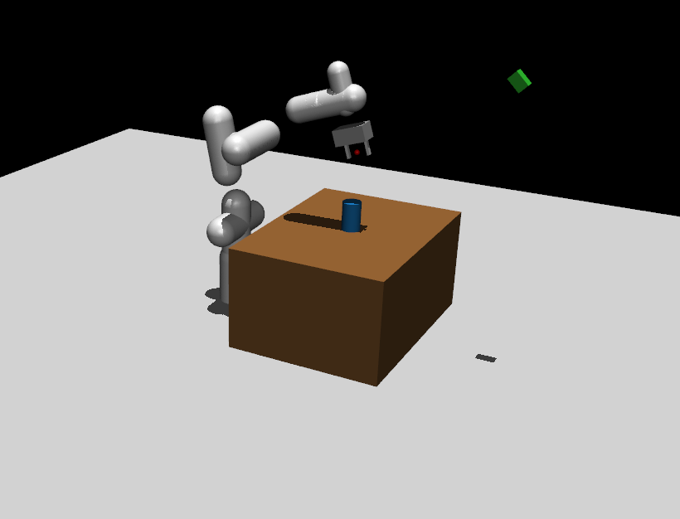
Scene in Mujoco

Slide 4
GraspNet Pipeline
1. Render Depth
2. Perturb Perception
3. Propose Grasps (CGN)
4. Execute via IK
MuJoCo camera captures depth from controlled viewpoint (φ, θ)
Add depth noise σ_d Downsample to ρ% → degraded point cloud C_pc
Contact-GraspNet returns N poses with confidence scores q_grasp
Best pose → DLS Jacobian IK → arm moves to grasp position
→
→
→
→

Slide 5
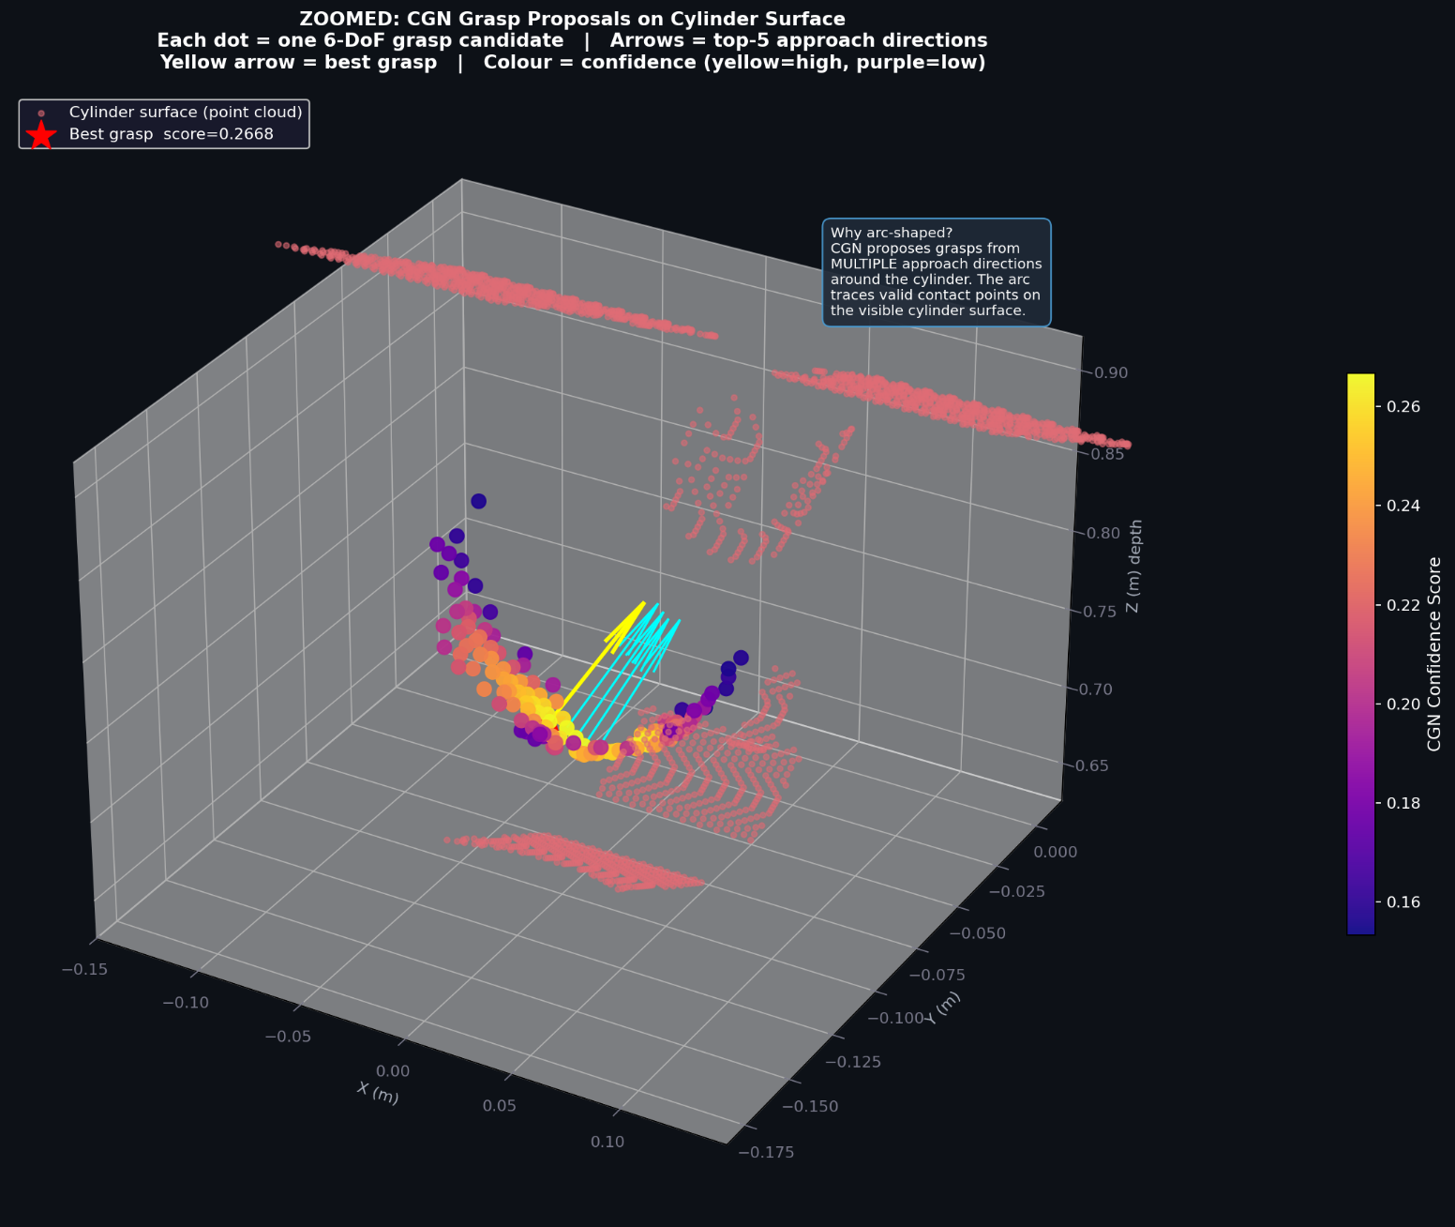
Poses in Contact Grasp Net

Slide 6
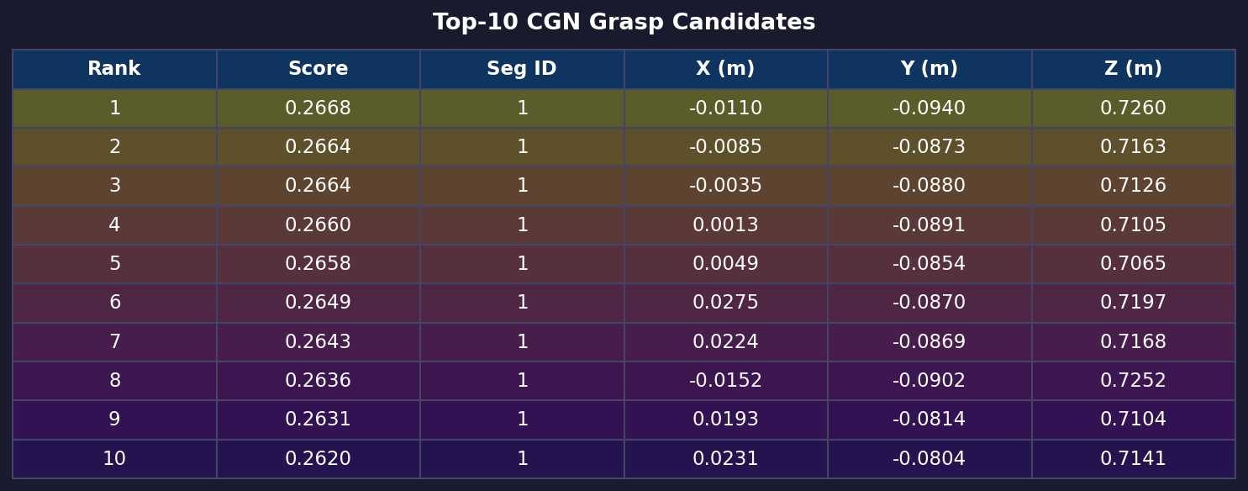
Confidence Scores

Slide 7
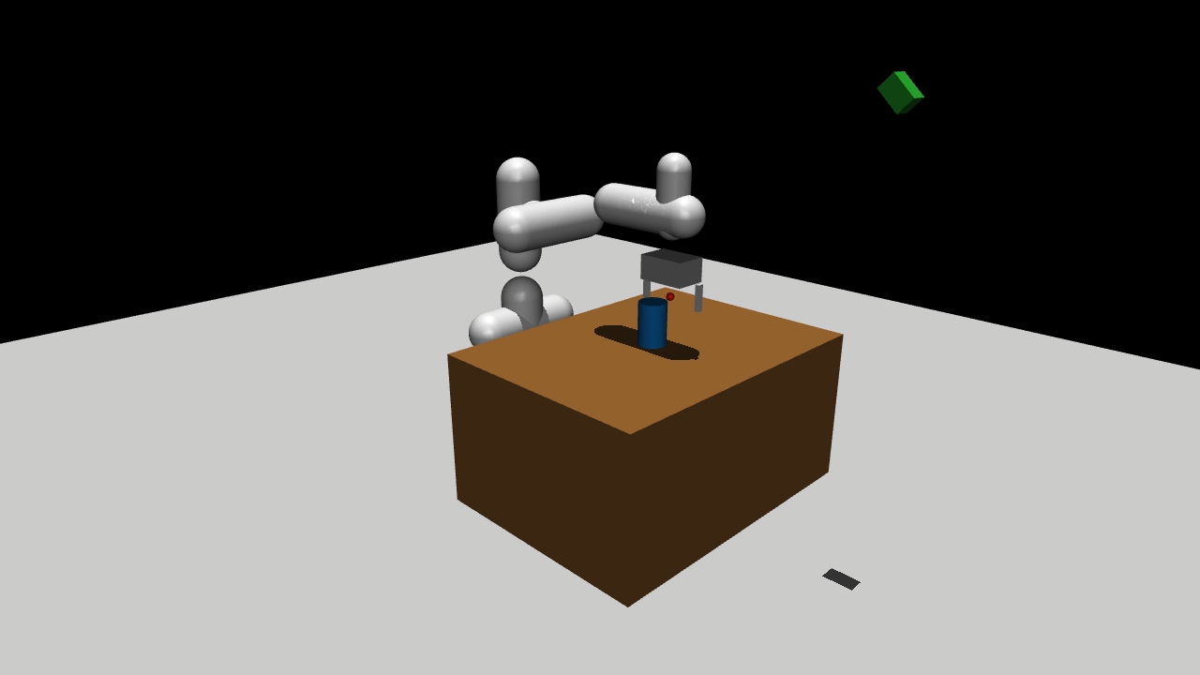
GRASP demo

Slide 8
Results: 432 trials
σ_d (noise)
Mean n_grasps
Mean q_grasp
Mean e_pose
Success rate
71 % success in clean conditions
0.000 (clean)
34.2
0.242
5.0 cm
71 %
Contact-GraspNet works well with full perception
0.005 (mild)
24.3
0.243
7.6 cm
43 %
0.020 (heavy)
3.2
0.202
11.1 cm
11 %
43 % with mild noise (σ=0.005)
0.040 (severe)
0.1
0.163
17.5 cm
0 %
Early degradation already halves performance
n_grasps drops 340x from clean to severe noise. e_pose grows 3.5x. Both reflect the same causal root.
Success rate by noise level:
0 % at σ_d = 0.040
σ_d=0
71 %
Severe noise → zero valid grasps → guaranteed failure
σ_d=0.005
43 %
σ_d=0.02
11 %
σ_d=0.04
0 %

Slide 9




Thank You!
#UofGWorldChangers
@UofGlasgow

